Slide 1
Finding
the International Space Station

Slide 2
What is ISS
It’s a Station in Space!
Effort of many countries
First components launched in 1998
About 420 Tons
About 110 x 73 x 20 metres
Speed: 7.67 km/s – It will get you to Sydney in 2 minutes!
Orbit height – 408 km
Why do we need it?
Research
Transport hub
Educational and Diplomatic purposes

Slide 3

Video

Slide 4
How do get updates from ISS?
The power of hobby
Both NASA and NORAD share some information with the general public and some passionate people, who are interested in all things space, use it for fun.
Nathan Bergey is one of them and he has built an API for all of us to get near real-time updates on what is happening out there 400 km above our heads.
What is API?
API – Application Programming Interface
It allows different programs to talk to each other over the network, like the internet.
We can read what an API shares with us too, just use your browser
and open http://api.open-notify.org/astros.json
What you see is response that even humans can make sense of and our computers could to! They just need to learn how to do it.

Slide 5
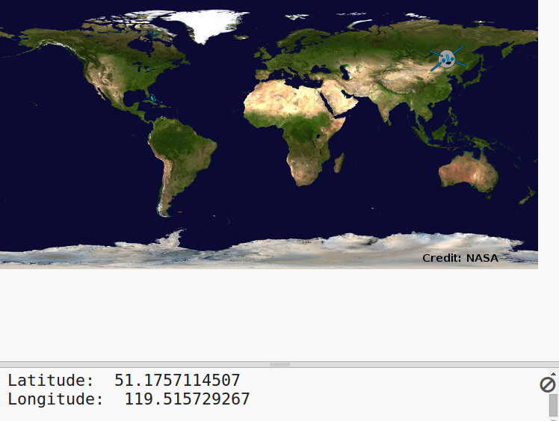
Let’s do what people in NASA do!
It’s not rocket science!
Today, with some python code we are going to show where the ISS currently is on a map so that we could monitor its movement in orbit!
At the end of the day, we are going to see a map with the station’s position and,
if we have time, play a little bit more with some other information we can get from ISS.

Slide 6
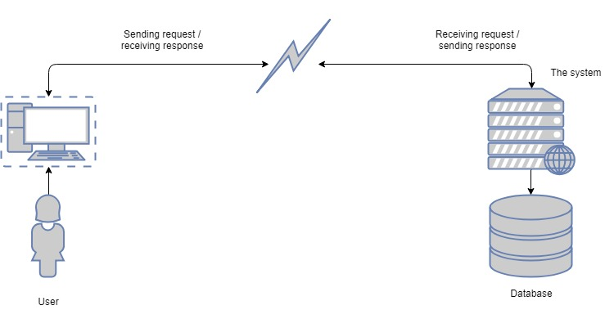
User – Api – Data
We can communicate with APIs!

Slide 7
Getting data and making sense of it
To get the data from the feed and set the lat lon variables:
import urllib.request, json
issUrl = 'http://api.open-notify.org/iss-now.json‘
response = urllib.request.urlopen(issUrl)
result = json.loads(response.read())
latitude = float(result['iss_position']['latitude'])
longitude = float(result['iss_position']['longitude'])

Slide 8
Creating a canvas space
Download the files from the repository and
put them in the same folder with your code
import turtle
# setting up the stage
screen = turtle.Screen()
screen.setup(720,360)
screen.setworldcoordinates(-180,-90, 180, 90)
screen.bgpic('map.gif')

Slide 9
Drawing the ISS on the map
# setting up iss
screen.register_shape('iss.gif')
iss = turtle.Turtle()
iss.shape('iss.gif')
# moving the iss figure to where it is right now
iss.penup()
iss.goto(longitude, latitude)
screen.exitonclick()

Slide 10
How to start
Information
Readme: https://github.com/Yury-Petrov/Mgc-Iss-workshop
API: http://api.open-notify.org
Now let’s do it!

Slide 11
Credits and links
Code club project: https://codeclubprojects.org/en-GB/python/iss/
Open-notify api: http://open-notify.org/
Github for open-notify: https://github.com/open-notify/Open-Notify-API
NASA: https://www.nasa.gov
NORAD: http://www.norad.mil/
Wikipedia: https://en.wikipedia.org/wiki/International_Space_Station
Template: https://www.free-powerpoint-templates-design.com/international-space-station-in-orbit-around-the-earth-powerpoint-templates/

